Slide 1

The Economic Case for Protecting the Public from Environmental Hazards
Leonardo Trasande, MD, MPP
Associate Professor of Pediatrics, Environmental Medicine and Health Policy

Slide 2
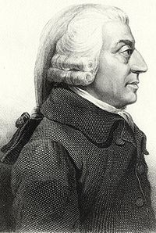
Adam Smith
Scottish philosopher (1723-1790) best known for Wealth of Nations
First modern work in economics
Outlined conditions for properly functioning market economy

Slide 3
Why would Adam Smith have cared about children’s environmental health?
Environmental hazards produce market failures (inefficiencies) that are costly to society
Externalities
Information asymmetry

Slide 4
Externalities
“Spill-over” effects
Market price does not accurately contain all the information about the benefits and costs of a transaction
When one agent’s behavior affects another’s utility
Notes:
Formal definitions
Buy/engage in activity if
Benefit/utility > price/cost

Slide 5
Example: Air pollution
Electricity producers emit particulate matter among other pollutants which are respiratory irritants
Children develop respiratory illnesses
Incur hospitalization, emergency room, prescription drugs and other costs (including loss of work and school)
Costs not borne by producers
Overproduce electricity compared to socially optimal amount
More disease and disability than society willing to pay

Slide 6

Information asymmetry
Typically hear about information asymmetry in health insurance context (adverse selection)
Producers may not disclose a product’s composition when it may have health or economic consequences
People at higher risk will pay more to buy a “healthier” product, whereas people at lower risk won’t
George Akerlof (2001 Nobel Prize Winner in Economics): The Market for Lemons: Quality Uncertainty and the Market Mechanism

Slide 7
Example: food contaminants
Fear of contamination drives prices down, and drives above-average goods out of the market
Ideally, price would be set correctly based on information about certain health risk associated with environmental exposure
Information uncertainty adds to the problem here (despite labeling)

Slide 8
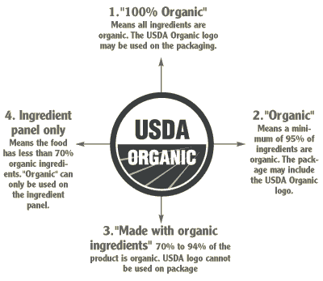
Organic labeling = perfect information?
Better, but still complicated
Controversies remain about what can be included in organic food

Slide 9
Information asymmetry & market failure
Fear of contamination drives prices down, and drives above-average goods out of the market
Ideally, price would be set correctly based on information about certain health risk associated with environmental exposure
Information uncertainty adds to the problem here (despite labeling)
George Akerlof The Market for Lemons: Quality Uncertainty and the Market Mechanism

Slide 10
So how much do these market inefficiencies cost as a society?
Largely don’t know
Toxic Substances Control Act of 1976 does not require premarket testing of chemicals
Epidemiologic studies post hoc take years
Outcomes have many potential confounders
Criteria of reproducibility, consistency
Uncertainty about dose-response relationships (also linear pedagogy), thresholds
Subclinical effects

Slide 11
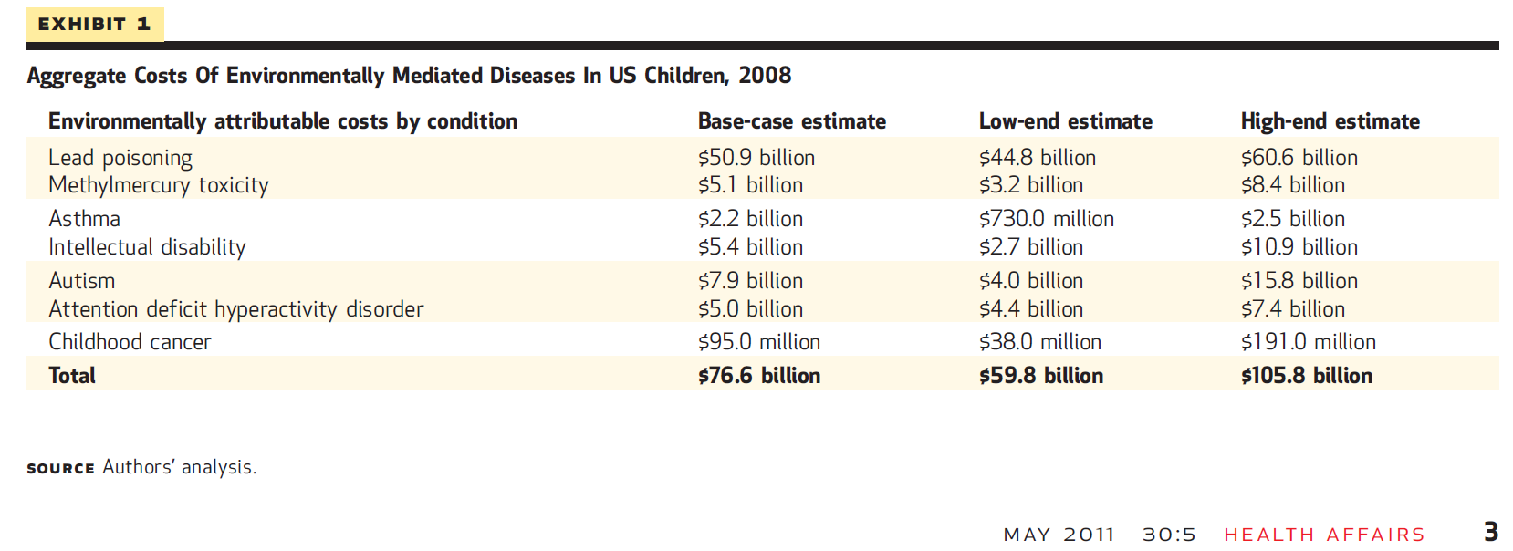
Most recent, best guess

Slide 12
Global costs
EU: environmentally-attributable costs of lead exposure, methylmercury exposure, developmental disabilities, asthma, and cancer to be $70.9 billion in 2008 (range: $58.9 billion to $90.6 billion)
0.48% of EU GDP
Low & middle income country lead exposure costs: $992 billion international dollars (1.22% of world GDP)
For comparison, US and Europe lead-attributable economic costs have been estimated at $50.9 and $55 billion, respectively.
Bartlett and Trasande Eur J Pub Health 2014
Attina and Trasande EHP 2013

Slide 13
Another problem from economists’ perspective
Majority of social costs are borne by society (lost economic productivity, social insurance)
Distributional problem: direct costs to individuals disproportionately borne by lower socioeconomic status populations (insofar as chronic conditions have this predisposition – asthma, for example)

Slide 14
What would Adam Smith do?
Government involvement might, but will not necessarily, provide a more efficient outcome
Even an efficient system may not result in a “desirable” distribution of goods

Slide 15
Examples of Government Intervention
Phasing out lead in gasoline
Pigovian tax
Polluter pays provision

Slide 16
Phasing Out Lead in Gasoline
Lead phased-out from gasoline (catalytic converters or kids?) beginning 1975
Fix discovered for catalytic converters: does lead get back in?
Only when data on lock-step decrease of blood lead levels and lead use presented is effort to phase back in blocked

Slide 17
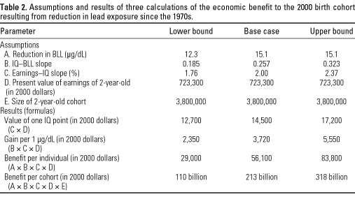
Retrospectively, a Wise Economic Decision
Grosse et al
Environ Health Perspect 110:563-569 (2002)

Slide 18
Global Benefits of Phasing Out Lead From Gasoline
Range from $1-$6 trillion/year, with a best estimate of $2.45 trillion/year. These benefits may also be expressed as 4% of global GDP.
Tsai and Hatfield 2011 J Environ Health

Slide 19
Pigovian tax
Tax equal to the amount of the economic damage suffered by those who experience the externality
Theoretically, if you can exactly measure the amount of the damage, and government transfers the money to those who suffer the consequences, would please Adam Smith
Rarely happens

Slide 20
Polluter pays provision
Penalty to polluter equivalent to economic harm suffered
Example: Superfund program
Practical application a major issue

Slide 21
Applying principles to a case study
Endocrine disrupting chemicals (EDC)
broad category of chemicals
widely used
limited epidemiologic evidence linking EDCs with health conditions
Prevention will ultimately require replacement with safer alternatives
Absent estimates of the burden of disease and disability potentially produced by EDC exposures, high costs of alternatives are likely to outweigh concerns about the health consequences

Slide 22
European context
In Europe, 2009 and 2011 laws mandate limits on pesticides and biocides with endocrine disrupting properties that may have harmful health and environmental effects
EU Commission has requested impact assessment to assess the economic implications of the criteria under discussion
To inform the impact assessment, we endeavored to quantify a range of health and economic costs that can be reasonably attributed to EDC exposures in the European Union

Slide 23
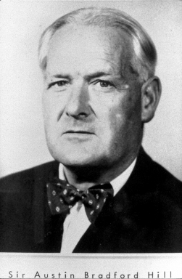
Causality criteria
Temporal relationship required
Others favor causality (major in bold)
Consistency
Effect size
Dose-response relationship
Biological plausibility
Specificity
Coherence (Coherent with existing theory/knowledge)
Experiment (Can be prevented or ameliorated)
Consideration of alternate explanations
Hill AB Proc Royal Soc Med 1965

Slide 24
Embracing uncertainty
“What I do not believe – and this has been suggested – is that we can usefully lay down some hard-and-fast rules of evidence that must be obeyed before we accept cause and effect.”
“On fair evidence we might take action on what appears to be an occupational hazard, e.g. we might change from a probably carcinogenic oil.”
Uncertainty “does not confer upon us a freedom to ignore the knowledge we already have, or to postpone the action that it appears to demand at a given time.”
Hill AB Proc Royal Soc Med 1965

Slide 25
So how to deal with uncertainty?
Intergovernmental Panel on Climate Change has dealt with similar issues, developing probability weighting for ranges of scenarios
Confidence level | Interpretation
Very high | 90-100% probability of causation
High | 70-89% probability of causation
Medium | 40-69% probability of causation
Low | 20-39% probability of causation
Very low | 0-19% probability of causation

Slide 26
How to integrate epidemiologic evidence?
The GRADE (Grading of Recommendations Assessment, Development and Evaluation) scheme is becoming increasingly popular and the preferred approach recommended for the development of WHO guidelines in the presence of uncertainty.

Slide 27
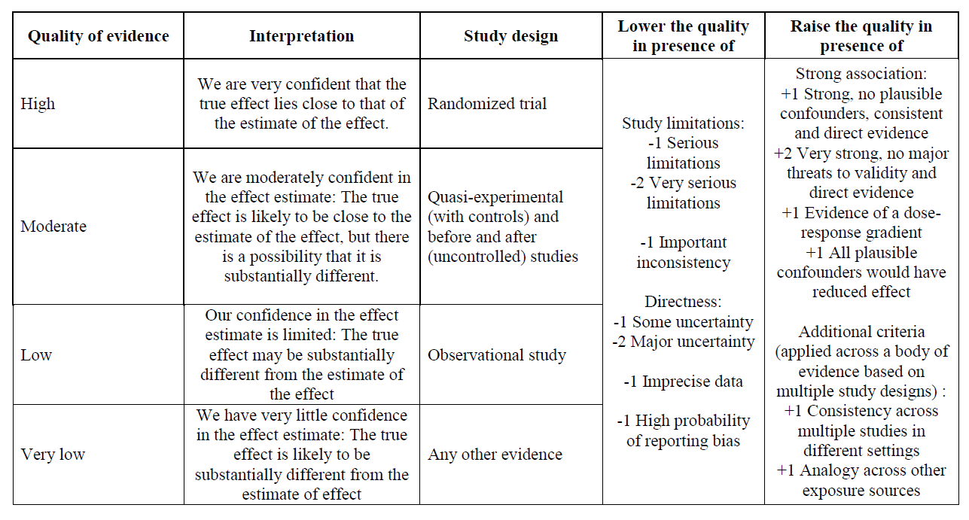
GRADE adapted for EDCs
Adapted from Atkins et al BMJ 2004 and Bruce et al WHO Indoor Air Quality Guidelines 2014

Slide 28
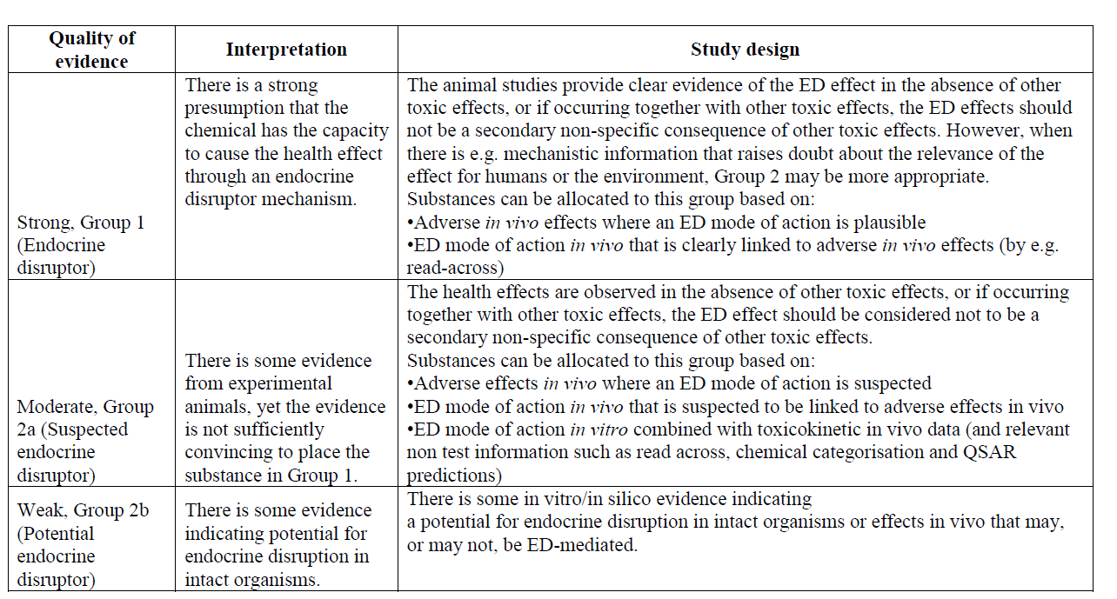
Danish EPA criteria for toxicologic evidence (adapted)
Adapted from Hass et al http://eng.mst.dk/media/mst/67169/SIN%20report%20and%20Annex.pdf

Slide 29
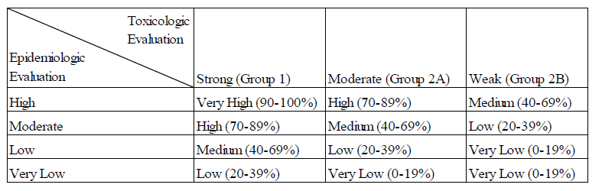
Adapting IPCC criteria to integrate epidemiologic and toxicologic evidence
Trasande et al JCEM 2015;
adapted from http://www.ipcc.ch/meetings/ar4-workshops-express-meetings/uncertainty-guidance-note.pdf

Slide 30
Application to estimate EDC disease burden and costs in EU (1)
During a two-day workshop in the spring of 2014, five expert panels identified conditions where the evidence is strongest for causation, and developed ranges for fractions of disease burden that can be attributed for EDCs.
Expert panel topics:
Neurodevelopment
Obesity and diabetes
Breast cancer
Male reproductive health
Female reproductive health
Trasande et al J Clin Endo Metab epub Mar 5 2015

Slide 31
Application to estimate EDC disease burden and costs in EU (2)
To quantify attribution, prioritized dose-response relationships from the epidemiologic literature
Also, in the presence of epidemiologic evidence for a dose-response relationship for another exposure that operates via a similar or identical mechanism, an estimate of an odds ratio or increment in disease was applied, when placed in the context of the strength of evidence assessment.
Trasande et al J Clin Endo Metab epub Mar 5 2015

Slide 32
Application to estimate EDC disease burden and costs in EU (3)
When dose-response relationship identified, the affected population within the EU was divided into quartiles or other appropriate groupings that permitted quantification of a differential effect with precision.
If there were no epidemiologic studies on which to assess a dose-response relationship, an increment in relative risk over baseline was estimated, and a prevalence of exposure was identified in order to estimate an attributable fraction, using the Levin equation:
AF = Prevalence_{exposure}*(RR-1)/[1+ (Prevalence_{exposure}*(RR-1))]
Trasande et al J Clin Endo Metab epub Mar 5 2015

Slide 33
Overall Evaluations
Exposure | Outcome | Strength of Human Evidence | Strength of Toxicologic Evidence | Probability of Causation
Polybrominated diphenyl ethers (PBDE) | IQ Loss and Intellectual Disability | Moderate-to-high | Strong | 70-100%
Organophosphate pesticides | IQ Loss and Intellectual Disability | Moderate-to-high | Strong | 70-100%
Dichlorodiphenytrichloroethane (DDE) | Childhood obesity | Moderate | Moderate | 40-69%
Dichlorodiphenytrichloroethane (DDE) | Adult diabetes | Low | Moderate | 20-39%
Di-2-ethylhexylphthalate (DEHP) | Adult obesity | Low | Strong | 40-69%
Di-2-ethylhexylphthalate (DEHP) | Adult diabetes | Low | Strong | 40-69%
Bisphenol A | Childhood obesity | Very low-to-low | Strong | 20-69%
Polybrominateddiphenyl ethers (PBDE) | Testicular cancer | Very low-to-low | Weak | 0-19%
Polybrominateddiphenyl ethers (PBDE) | Cryptorchidism | Low | Strong | 40-69%
Benzyl and butylphthalates | Male Infertility, Resulting in Increased Assisted Reproductive Technology | Low | Strong | 40-69%
Phthalates | Low testosterone, Resulting in Increased Early Mortality | Low | Strong | 40-69%
Multiple exposures | ADHD | Low-to-moderate | Strong | 20-69%
Multiple exposures | Autism | Low | Moderate | 20-39%
Trasande et al J Clin Endo Metab epub Mar 5 2015

Slide 34
Pesticides (used in agricultural production and homes)
13 million lost IQ points in each EU country → €124 billion lost earning potential
59,300 born each year with intellectual disability = additional €21.4 billion
1,555 obese 10 year olds = €24.6 million
28,200 50–64 year olds with diabetes = €835 million
Bellanger et al, Legler et al J Clin Endo Metab epub Mar 5 2015

Slide 35
Phthalates (used in food wraps, cosmetics, shampoos, vinyl flooring)
24,800 additional deaths among 55 – 64 year old men = €7.96 billion in lost economic productivity
618,000 additional assisted reproductive technology procedures costing €4.71 billion
53,900 50-64 year old women are obese = €15.6B
20,500 50-64 year old women are diabetic = €607M
Hauser et al, Legler et al J Clin Endo Metab epub Mar 5 2015

Slide 36
Flame retardants (used in electronics, furniture, mattresses)
873,000 lost IQ points →€8.4B lost earning potential
→3,290 intellectually disabled children = additional €1.9 billion
6,830 new cases of testicular cancer = €850 million
4,615 children born with undescended testis = €130 million
Bellanger et al, Hauser et al J Clin Endo Metab epub Mar 5 2015

Slide 37
Other estimates of burden and disease and costs
316 autistic 8 year olds each year (multiple EDCs) = €199 million
31,200 10 year olds with ADHD (multiple EDCs) = €1.7 billion
Bisphenol A (used in aluminum can linings, thermal paper receipts): 42,400 obese 4 year olds each year = €1.54 billion
Bellanger et al, Legler et al J Clin Endo Metab epub Mar 5 2015

Slide 38
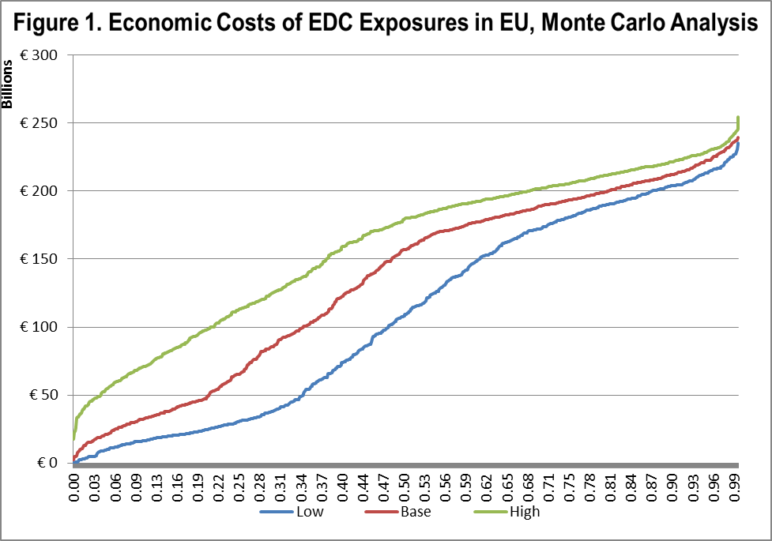
Monte Carlo Analysis
Trasande et al J Clin Endo Metab epub Mar 5 2015

Slide 39
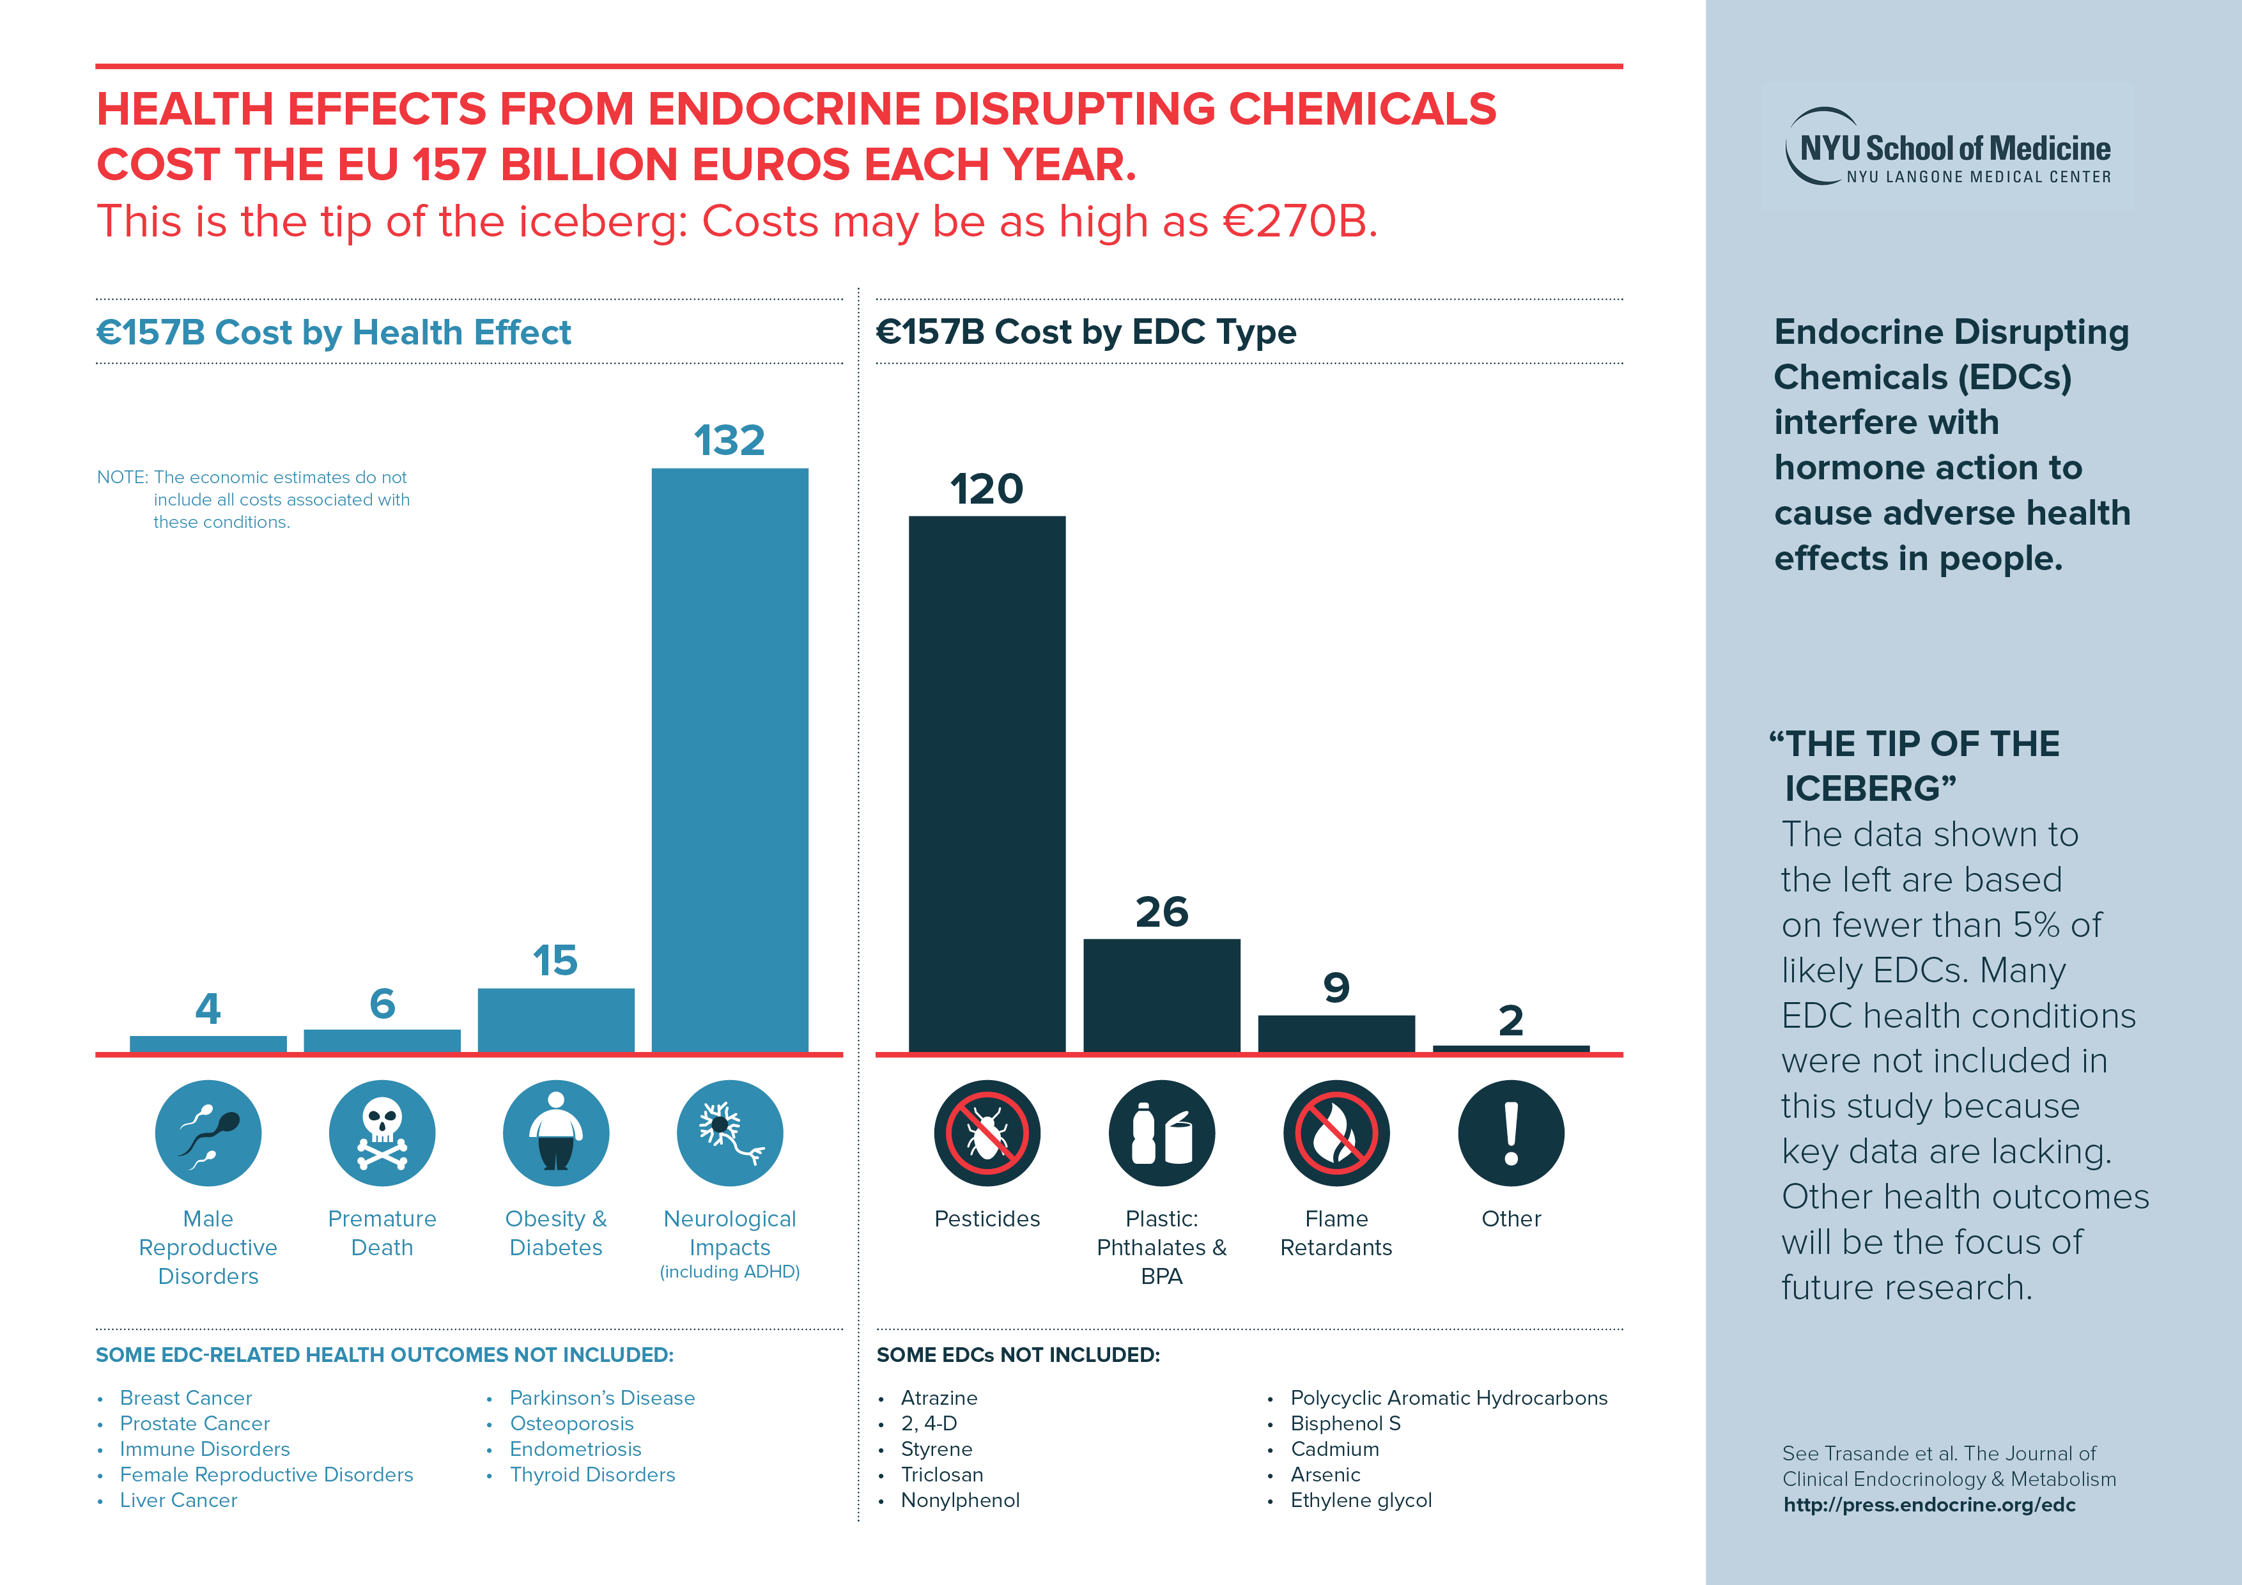

Slide 40
Likely a substantial underestimate
<5% of EDCs considered
Endometriosis, fibroids, breast cancer and many other conditions not included yet, but will be focus of future work
Economic numbers do not consider all costs associated with these chronic conditions
Limiting our exposure to the most widely used and potentially hazardous EDCs is likely to produce substantial economic benefit.

Slide 41
Implications for US
Findings from Europe strongly suggest that a similarly large burden of disease may be attributable to EDCs in the United States
Data from the Centers for Disease Control and Prevention suggest that exposures to EDCs are in many cases equal to if not higher than those in the EU.
More importantly, this speaks to the importance of reprising these analyses in the US context.

Slide 42
Importance of policy
Cost of brominated flame retardants likely to be higher in the US, as use is more stringently limited in Europe.
Levels of phthalates (DEHP) have decreased 17-37% in the US between 2001-10 and costs of attributable disease are likely to have decreased over that period.
EDCs are used globally, and our findings support careful regulation as part of the Strategic Approach to International Chemicals Management.

Slide 43
Returning to the US context: BPA
BPA banned in baby bottles and sippy cups
But not in other food uses
Potential cost of one BPA alternative, oleoresin = $0.022 per can
100 billion aluminum cans are produced annually
100 billion x $0.022 = $2.2 billion

Slide 44
Health costs associated with BPA exposure
Cost-of-illness methods for childhood obesity and adult coronary heart diseases
Utilized exposure data from NHANES 2003-8
Counterfactual scenario modeled using intervention studies that quantified decrements in BPA associated with removal of BPA in food sources
Trasande Health Affairs 2014

Slide 45
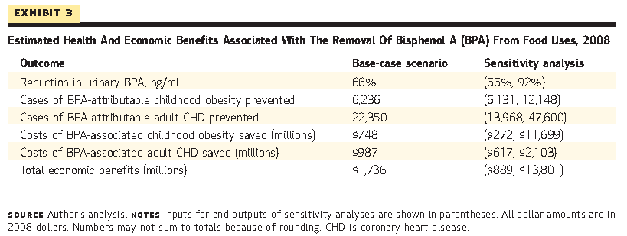
Benefits and costs of replacing BPA

Slide 46
Summary
Environmental exposures in childhood are driven by economic forces
These are market inefficiences
Impose large costs on society
Large economic benefits can result from prevention
Difficulty presented by latency to identifying environmental health effects
Uncertainty in health outcomes should not preclude estimation of potential economic benefits associated with prevention

Slide 47
Thanks!
Economic costs of environmentally mediated diseases
Teresa Attina
Emily Bartlett
Yinghua Liu
Funding: R24TW005962, R21ES018723
Funding for other non-economic projects
NIEHS (R01ES022972)
NIDDK (R01DK100307)
CDC/NIOSH (U01OH010394, U01OH010714)

Slide 48
Thanks!
EDC burden of disease and costs in EU
Steering committee: R. Thomas Zoeller, Andreas Kortenkamp, Phillippe Grandjean, Roberto Bertollini, David Tordrup, Loretta Doan, John Peterson Myers, Joe DiGangi, Martine Bellanger, Jerry Heindel
Expert panel leads: Russ Hauser, Ana Soto, Paul A. Fowler, Patricia Hunt, Juliette Legler, Ruthann Rudel, Niels Skakkebaek
Other participants: Ana Soto, Annette Pruss-Ustun, Barbara Cohn, Frederic Bois, Soeren Ziebe, Sheela Sathyanarayana, Germaine Buck-Louis, Jorma Toppari, Andreas Kortenkamp, Anders Juul, Ulla Hass, Bruce Blumberg, Miquel Porta, Eva Govarts, Barbara Demeneix
Funding: John Merck Fund, Forsythia Foundation, Broad Reach, Marisla Foundation, Oak Foundation

